Slide 1

“Click Here to Kill Everyone”... introducing the Internet of Things — <<code>>
COM3505, Lecture 1
Prof Hamish Cunningham
Notes:
music: frida: The-Matrix--Soundtrack--Juno-Reactor-Vs-Don-Davis---goo.gl-LlSTwA.mkv

Slide 2
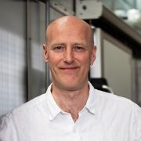
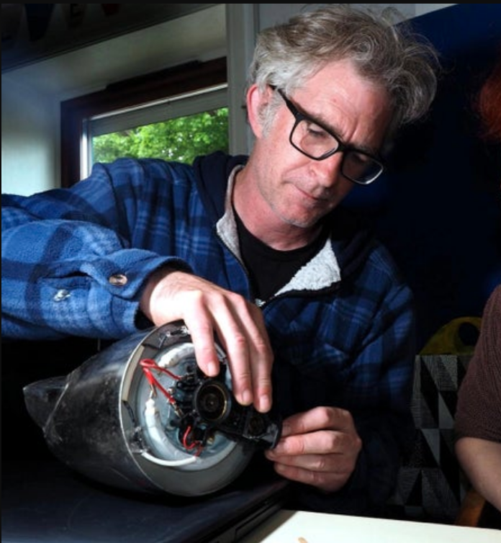
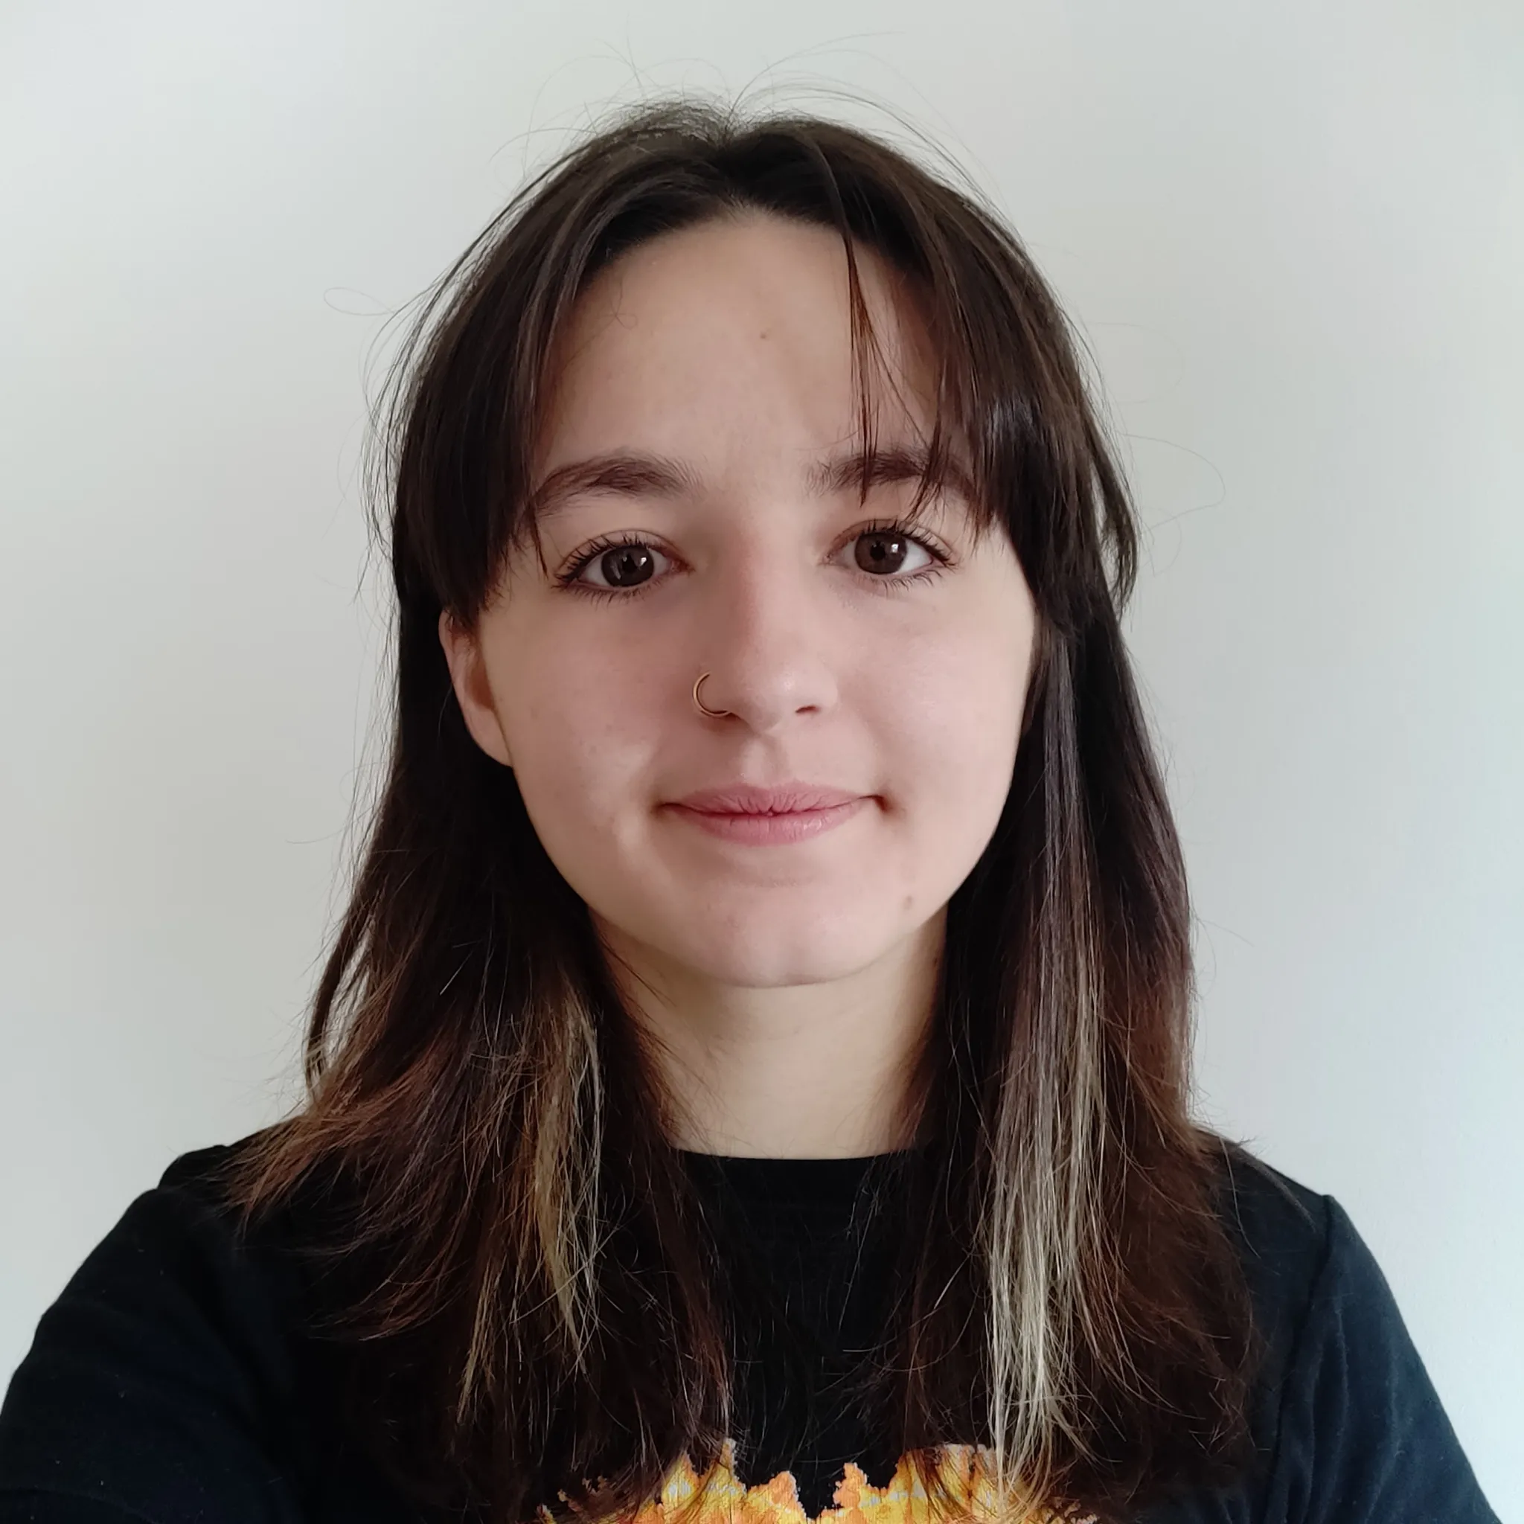
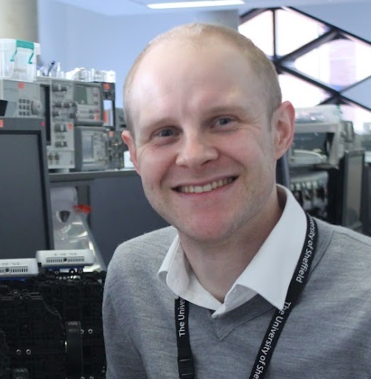
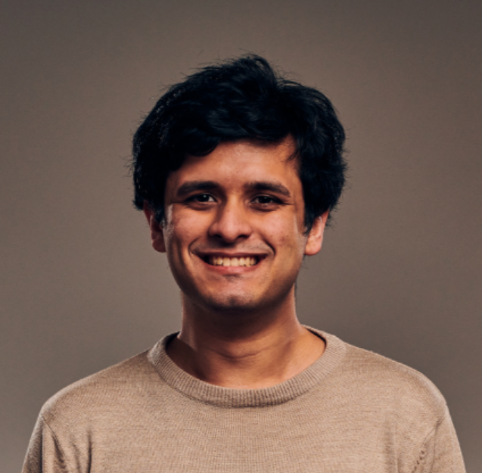

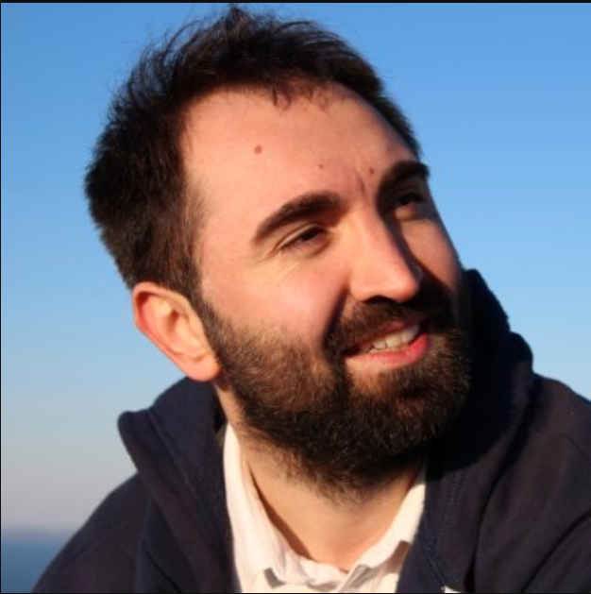
Hello!
And welcome to spin 7 of COM3505…
The course this year will be taught by:
Hamish Cunningham hamish.gate.ac.uk
Gareth Coleman reyt.repair/bitfixit.co.uk
Tom Howard
Mary Hewitt
Zalán Lévai
Areeb Sherwani
Valentin Radu vradu.uk
Today we’ll cover:
What is the IoT?
the course programme, how to pass, how you are assessed
delivery over gitlab, the notes & exercises, hardware kits
Q&A, week 1 TODOs

Slide 3
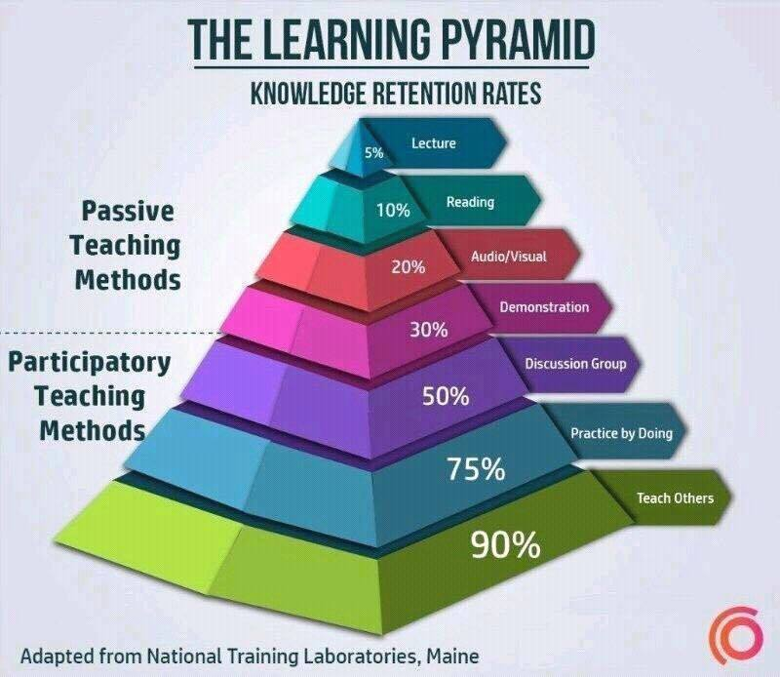
Who’s going to learn the most...
... out of everyone in this “room”?
Me!
Help yourself to learn by:
building stuff (this is a practical course!)
figuring out what I’ve missed or got wrong! (and telling me, or better still fixing it in the course git repo and sending me a pull request)
discussing with your peers (lab work is in pairs, mostly)
teaching others about what you’ve learned (but not doing their work for them!)
reading critically around the subject (and there’s plenty to read!)
and…

Slide 4
Learning to help, helping to learn: discussion group
For the last couple of years we’ve run a discussion board where you can ask questions, share code solutions and so on.
This worked well, so we’re keeping it this year.
The core facility is on Blackboard (groan?), but we also have a Discourse forum at forum.unphone.net
Use them like stack exchange or gitlab issues or a developer forum:
when you’re stuck ask a question
read others’ questions and make suggestions
There’s no such thing as a stupid question!
#1 piece of advice for learning well:
Keep talking! Participate in the discussion groups! Let us know what you like and what you don’t! Send me 000s of £s in used notes!</joke>

Slide 5
Good news / bad news
the tricky bit:
this is the final stretch of your degree with lots of deadlines, so it is challenging to have an open-ended assignment (LA2) at this point
the freedom to experiment is great but guidance on the parameters is a big help
helping you cope:
we publish assessment 2 before Easter (if you wish you can almost finish the course over the holiday!)
LA1 is a (smaller) dry-run for LA2, so feedback from LA1 can guide you in LA2
pressure of space in DIA 2.02 means you will need to share workstations, and mostly you will be assessed as a team of 2 for LA1 and LA2, if you (both) wish
in the lab please try to sit in the same place each week, and please print your name / email on a sheet of paper beside you on the desk

Slide 6
Changes from last year
hardware platform has stabilised; ESP32S3 is still microprocessor of choice for a large segment of the IoT ecosystem, so great platform to be learning
chronic parts shortage since pandemic is finally easing
releasing end user version of the unPhone (only around 3 years late, but hey ho)
stable docker + platformio + web serial build method, that works well on Windows and Mac as well as (of course) Linux
IDF and Arduino core versions: we’re still using 4.4.x and 2.0.x releases while waiting for 5.1.x / 3.0.0 (the latter is in alpha at present and will likely need a fair bit of migration work)
the climate crisis is finally over and we’re no longer rushing headlong to emulate the lemmings (only joking, unfortunately)

Slide 7
So: what is the Internet of Things (IoT)?
A world robot?!
...the Internet of Things has three parts. There are the sensors that collect data about us and our environment... Then there are the “smarts” that figure out what the data means and what to do about it... And finally, there are the actuators that affect our environment. … You can think of the sensors as the eyes and ears of the internet. You can think of the actuators as the hands and feet of the internet. And you can think of the stuff in the middle as the brain. We are building an internet that senses, thinks, and acts. This is the classic definition of a robot. We’re building a world-size robot, and we don’t even realize it.
(Schneier 2017, Click Here to Kill Everyone)
At the other extreme…:

Slide 8
What is the IoT (2)? (more prosaically)
At the other extreme the IoT is about what becomes possible when:
networked microcontrollers* become cheap enough to embed in very many everyday contexts,
from central heating thermostats to garage doors:
a massive expansion of the application space of computational devices.
These devices face tight constraints of power usage (or energy) and cost, and
concomitant challenges to their security and functionality.
They also quickly become extremely numerous, driving work on
big data analytics and
cloud computing.
*MCU: i/o, memory and small CPU on a chip — the smallest single die unit of computation; cf. SoC, System on a Chip, which adds peripherals like video, USB, maybe ethernet, etc. etc., and microprocessor, (big!) CPU only

Slide 9
History, antecedents… a crossover point
The tech: networked devices go back perhaps 50 years or more; the term IoT itself is often credited to Kevin Ashton in 1999 (working on what became RFID at the Auto ID Lab at MIT).
Related and predecessor fields include:
embedded systems: computation built into devices with specific purposes (i.e. not general purpose computers)
ambient computing or ubiquitous computing: the trend for computation to move into more and more devices (Schneier: “We no longer have things with computers embedded in them. We have computers with things attached to them.”)
physical computing (or cyber-physical systems): computation dependent on sensor input and/or producing actuator output
distributed computing: jobs performed by multiple machines operating in concert
utility computing: the as-a-service model: software as a service, data as a... (“XAAS”)
the cloud: utility distributed computing
new buzz words: serverless (um, servers+software); fog (shift work back to the edges)
new kid on the block: generative AI. Thought for the day: if LLM safety is like DRM’s analogue hole (impossible to fix by definition), how safe will the world robot project be?!

Slide 10
Course programme
Cloudside; choose project: unPhone? DIY alexa? smartwatch? etc. [Lab Assessment 1.] [Easter break.]
IoT applications.
AI at the Edge. [vr] [Mock]
WaterElves, Gripples and Fish Poo: IoT case studies
IoT 2022 Review.
The Future… [Lab assessment 2.]
[Exam quiz (exam period).]
Introduction; define the IoT; get to know the lab
SDKs, IDEs, toolchains; burning firmware.
More history; blinking, sensing, WiFi.
Country of the blind (and lame): networking (and updating) devices without user interfaces.
Local protocols: sensing and responding. [gc]
Machine learning & analytics for MCUs. [vr]
Labs: hacking connected devices
Labs: engineering your project

Slide 11
How to pass COM3505
This is a 10 credit level 3 course. Assessment is by:
threshold and grading
threshold: assessment 1 (week 7) and the exam (week 12+, mock in week 9) are pass/fail; they contribute 40 marks (or 0!)
assessment 2 (the project; weeks 8 — 12) contributes <= 60 marks:
code pushed to gitlab
documentation (inc. a 60 sec video of your work in action)
Notes:
there are code exercises each week; solutions are in the gitlab repo
you can often build on the n-1 solutions for exercises in week n (so don’t worry if you find a particular week hard)
the exam depends mostly on the reading materials and lectures
more details on the marking scheme are given when the assessments start, but the key thing to remember is that the first assessment and exam are pass/fail, whereas the project is qualitative and open-ended

Slide 12
A tale of two gitlabs (an open source course!)
we communicate with you via the course notes: iot.unphone.net; the sources are at: gitlab.com/hamishcunningham/the-internet-of-things; later on you may also need gitlab.com/hamishcunningham/unPhoneLibrary
you communicate your work to us via your own private gitlab repo (we tell you how to set this up in chapter 1 of the course notes)
each notes chapter (one per week) has two parts, theory and practice
read the first parts of the chapters in lean-back mode: they are discursive, and give a flavour of the field and its historical and technical contexts
the second parts give instructions for a week’s worth of practical work; go through these sections on your development machine and in the lab
the more code you write, the more hardware you build, the more you learn!
when we assess you (weeks 7 and 12) we snapshot your gitlab repo; get used to pushing there regularly (e.g. every day or two)
links to slides and etc. are on Blackboard

Slide 13
[Infrastructure: GitLab]
Linus Torsvald's Very Short Christmas Card List...
2005: BitKeeper access for Linux Kernel development withdrawn, Linus decides to implement his own…
“Git is a term of insult with origins in British English denoting an unpleasant, silly, incompetent, stupid, annoying, senile, elderly or childish person. As a mild oath it is roughly on a par with prat and marginally less pejorative than berk.”
Linus: "I'm an egotistical bastard, and I name all my projects after myself. First 'Linux', now 'git'."
Git is...
entirely appropriate for at least one project in the world (the Linux Kernel: 15 million lines of code, thousands of developers, >2 billion installations...)
a bit like swatting a fly with a pile driver for most other projects?!
Fortunately, GitLab is...
a user-friendly service wrapping Git
full of handy collaboration tools, supporting various workflows
open source
useful for running code-based courses like this one, and an industry standard
[We used to use GitHub, but it got bought by Microsoft (revise the browser wars to see what good news this is!). Enter GitLab :) ]

Slide 14
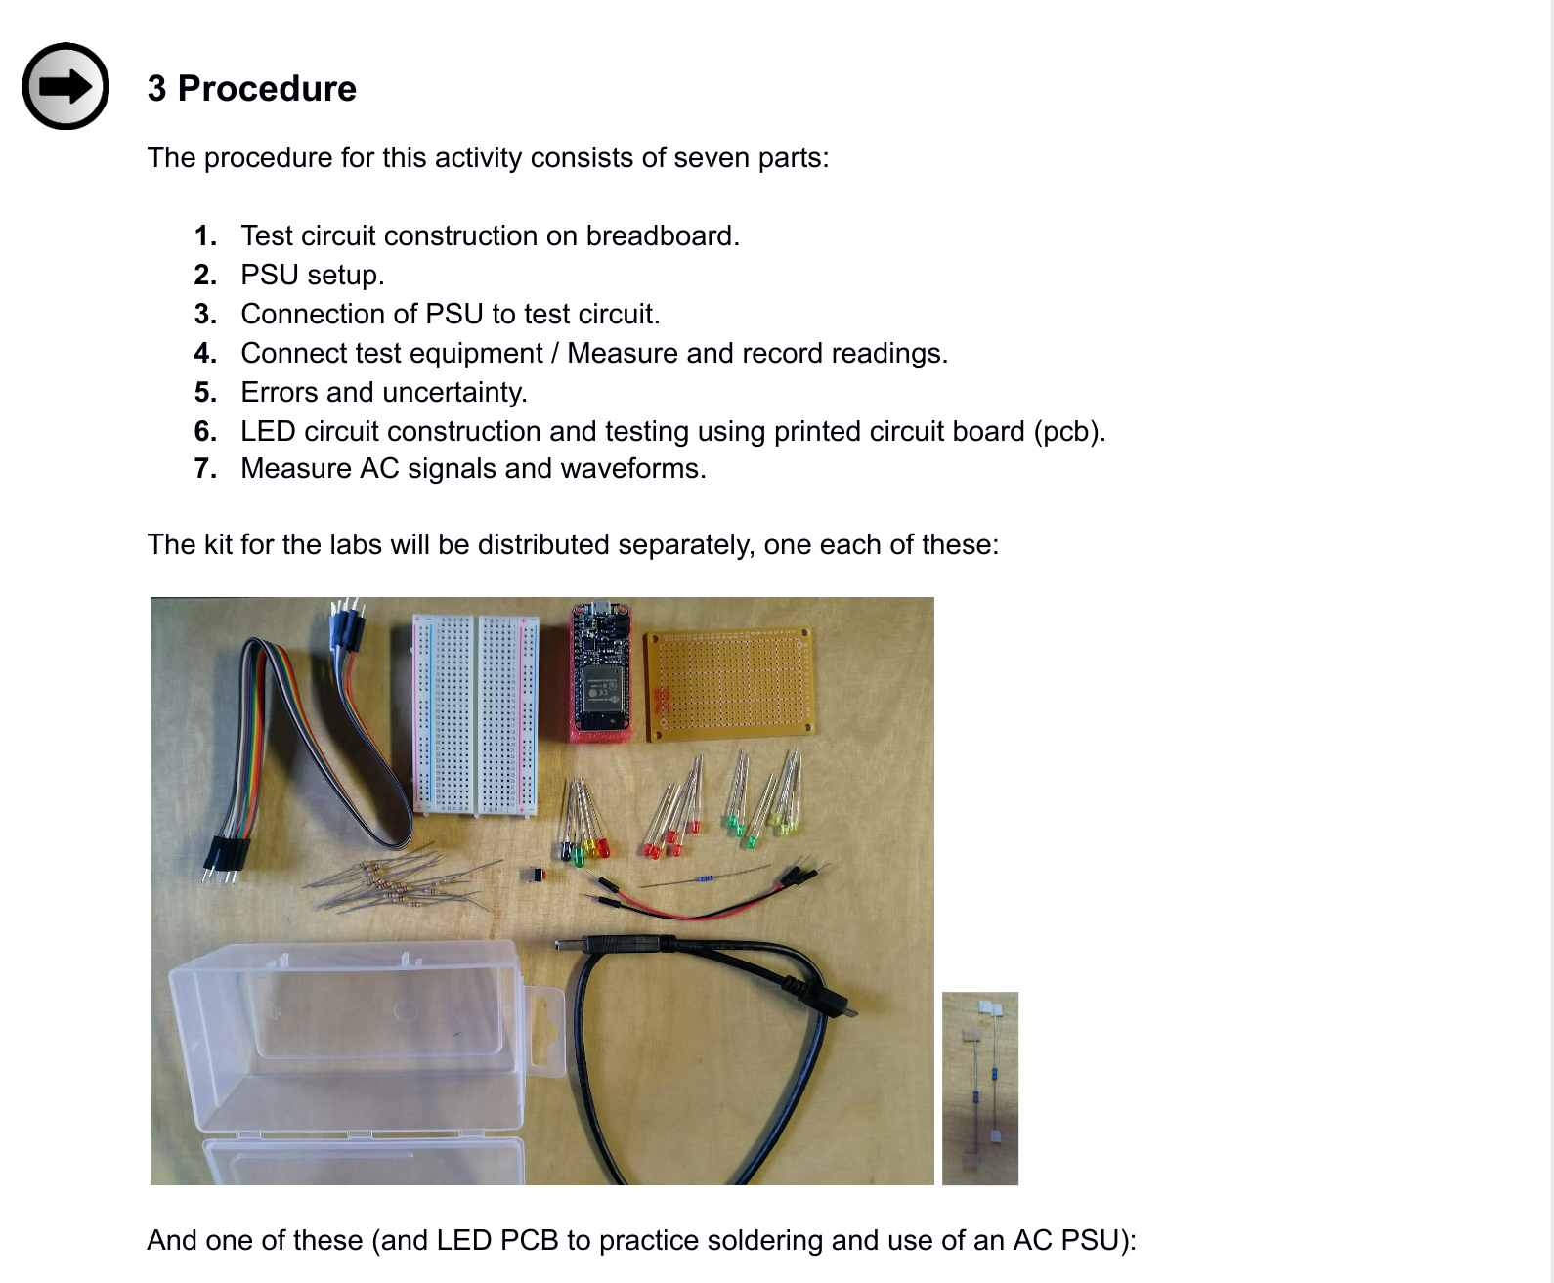
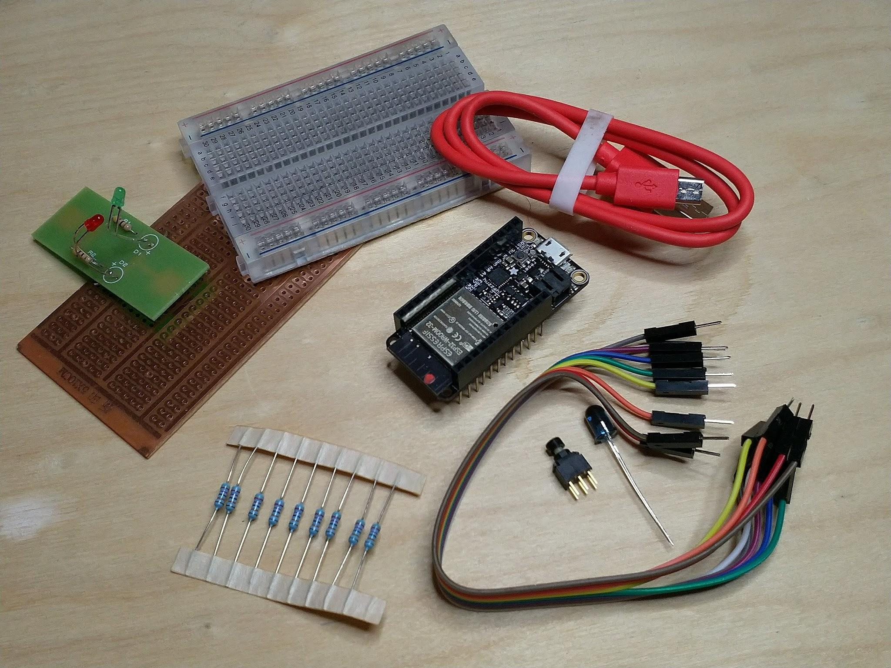
Hardware; first lab session
A week’s work: https://iot.unphone.net/#com3505-week-01-course-notes
The parts kit for weeks 1 — 8:

Slide 15
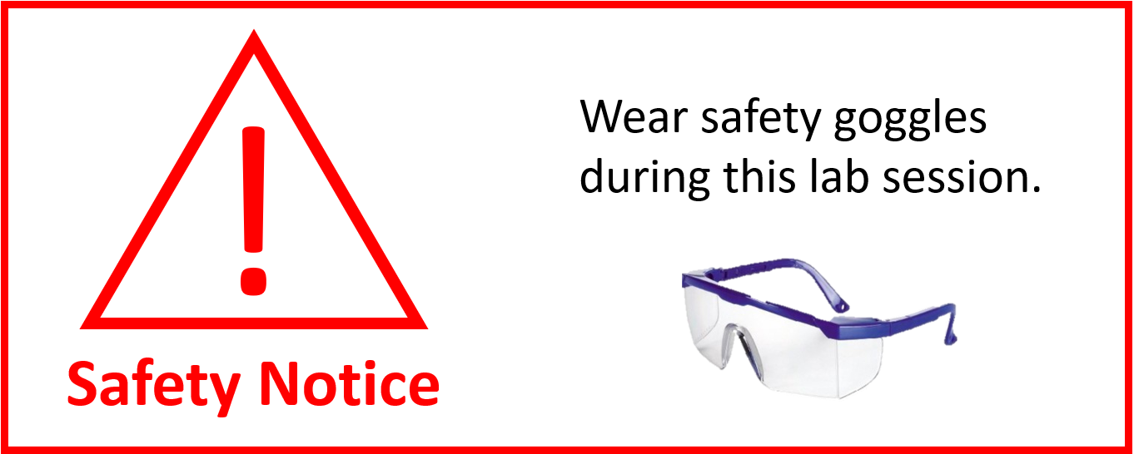
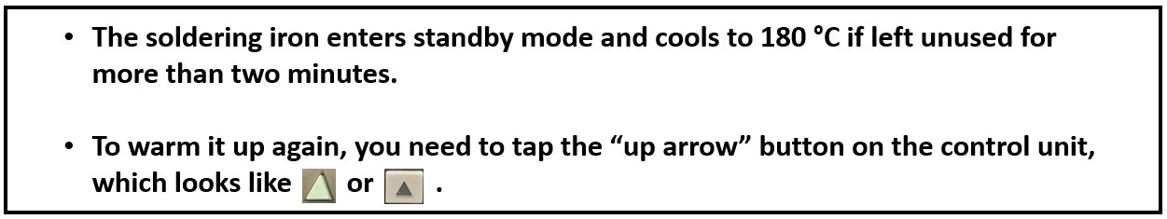
Soldering: optional but useful; be careful!

Slide 16
Your TODO list for week 1:
TODOs:
create a GitLab repo, add me as maintainer, and tell us your ID
clone your GitLab repository and practice using it (all your work must be pushed here)
read and digest chapter 1 of the notes: iot.unphone.net
(sources: gitlab.com/hamishcunningham/the-internet-of-things)
as discussed in the lecture, work through the week 1 notes, starting in the lab session
do some “further reading”, poke around, explore
participate: post questions to the discussion board, make a pull request on the course repo, send me an email at hamish@gate.ac.uk
have fun!

Slide 17
Questions?
(remember the learning pyramid!)

Slide 18
THE END

Slide 19
Old slides follow
(use them at your own risk!)

Slide 20
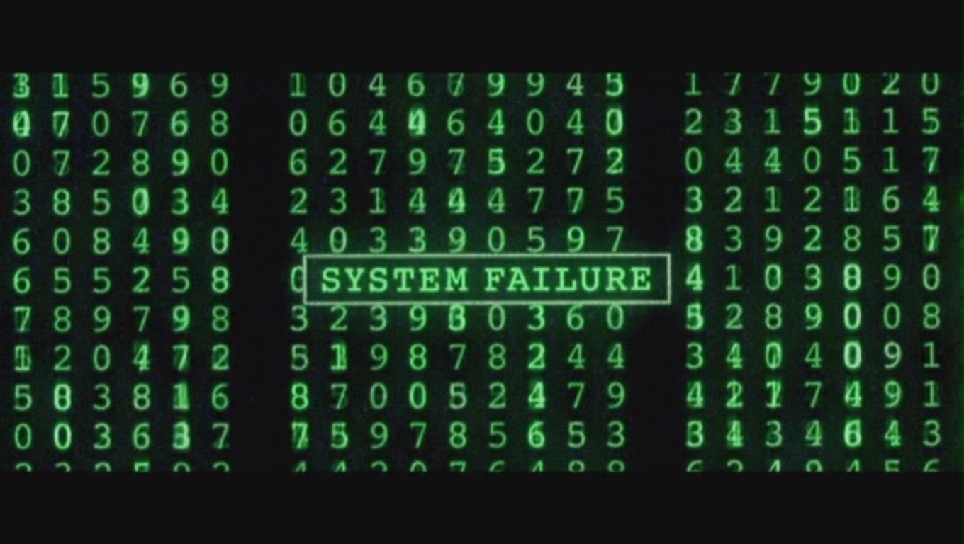
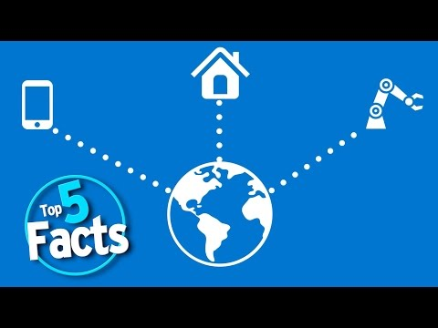
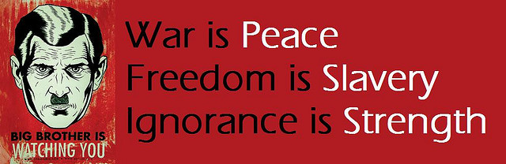
Double Plus Ungood or Bellyfeel Goodthink?
Spot the references?
(See also: Gattaca, Elysium, Minority Report …)
Rise of the machines: who is the ‘internet of things’ good for? (Greenfield) https://goo.gl/uIUCrD
Unauthorized Bread, Cory Doctorow (in Radicalized, 2019)
Notes:
which famous books or films do these come from? who’s built a website? https, ssl, … on IoT?

Slide 21
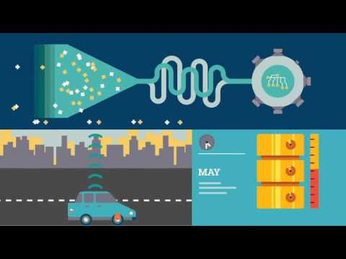
An IoT view
from IBM
Notes:
0.40: platform?
1.00: analytics?
1.45: gateway?
2.20: asset management sys?
Remember: read (or watch) critically!

Slide 22
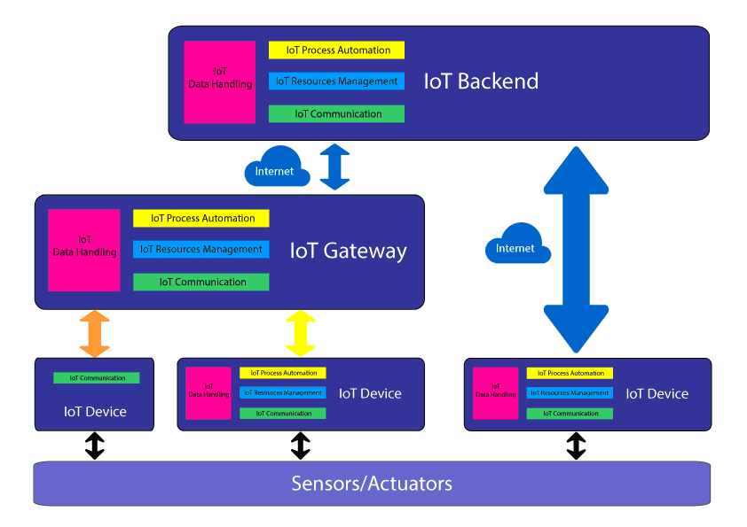
Software Architecture and the IoT (“fog”?!)
Aside from the devices themselves (connected microcontrollers running sensor/actuator rigs), IoT systems will typically also involve one or more of:
a platform, or backend (e.g. IFTTT, AWS IoT, IBM Watson or Adafruit.io)
a gateway (e.g. Google Home, Phillips Hue Bridge, Amazon Echo, Siemens Mindsphere MindConnect, a Pi...)
communications protocols (e.g. TTN, MQTT, COAP, HTTP, SSL/TLS...)
big data processing (Hadoop, Storm, Samza, Spark, Flink…) & analytics
(forklog.net)
….What to teach?!
Notes:
we could be teaching you the corporate view of the IoT… AWS, IBM, Siemens, ...COM3505: build stuff, corporation-agnostic …. ASR, “Bonsley”

Slide 23
Hardware (1): the ESP32
New wave wifi microcontrollers from fabless chip manufacturer Espressif:
started making a splash with the ESP8266 in 2014
an order of magnitude cheaper and more powerful than equivalent AVR-based boards (though new entrants are catching up!)
Arduino-compatible layer made programming it much easier, and made Arduino sensor/actuator code reusable
ESP32 released 2016 adding:
dual core (wifi etc. runs on one — “protocol core”, user code on the other — “app core”)
Bluetooth LE
more GPIO
touch and temperature sensors
2019: ESP32-S2, single core but stronger crypto etc.
2021: ESP32-S3 (dual core Xtensa), ESP32-C3 (single core RISC V, lower power?). Yes, there is a single letter difference between the names of these radically different chips!

Slide 24
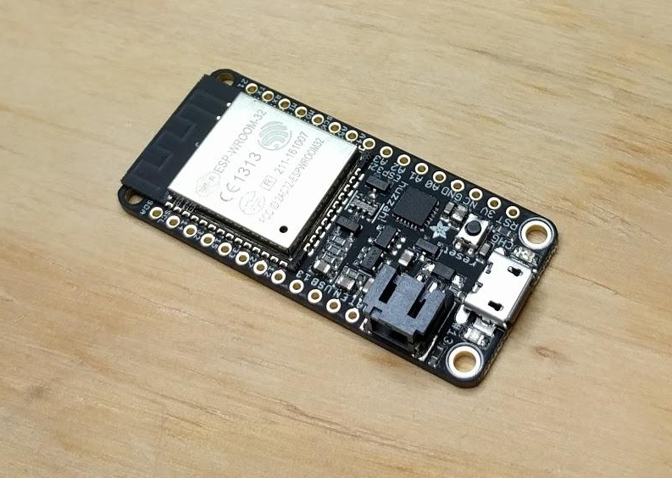
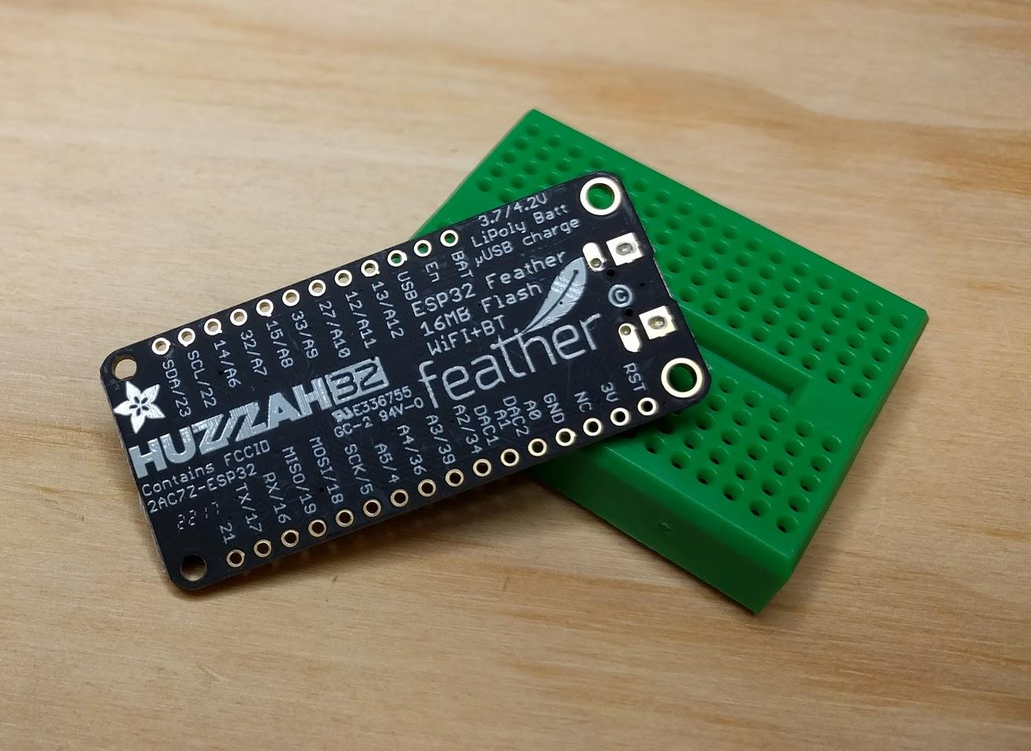
Hardware (2): the ESP32 (contd.)
our boards: Adafruit Huzzah ESP32 Feather
a robust board with built-in LiPo charger, USB to serial, automatic bootloader reset
part of the Feather range, which includes add-on motor drivers, RF, TFT and OLED screens, relays, midi synth...

Slide 25
How do we program it? (1: firmware in C++)
Arduino is both a hardware platform (originally based on AVR microcontrollers) and an IDE — from https://arduino.cc — that has lead the way on open embedded computation since 2005.
C++ is a high- (or medium-) level language layered on the C systems (low-to-medium level) programming language.
Arduino C++ refers to preprocessing, macros and libraries that are available via the IDE.
The ESP32 is not an AVR-based device, but there is a compatibility layer that interfaces it to the Arduino IDE. This makes lots of code for sensors and actuators and etc. magically available for the ESP.
We’ll use the Arduino IDE to get going with ESP firmware development in the first half of term. We’ll look at other options later on (the native development environment from the chip manufacturer, IDF, PlatformIO or Eclipse CDT).

Slide 26
How do we program it?
How do we program it? (2)
We’re NOT teaching you C[++]!!!
Huh?!
You’re all already programmers: you no longer need to study every bracket and comma of the syntax of new languages.
You’re nearly professionals: so you need to get ready to beg, borrow and steal (i.e. google it, copy it, share your improvements) your next bit of code inspiration.
Quick! Learn C! Some resources to help:
www.learn-c.org
www.tutorialspoint.com/cprogramming
www.tutorialspoint.com/cplusplus
www.learncpp.com
On GNU Linux or Ubuntu:
www.network-theory.co.uk/docs/gccintro
askubuntu.com/questions/36520/how-could-i-begin-c-programming-on-ubuntu
Most of all, rely on the libraries, example sketches, and (as term goes on) the set of solutions we distribute via your git repositories.
We’re teaching you to solve problems and develop solutions in a new environment. Good luck!

Slide 27
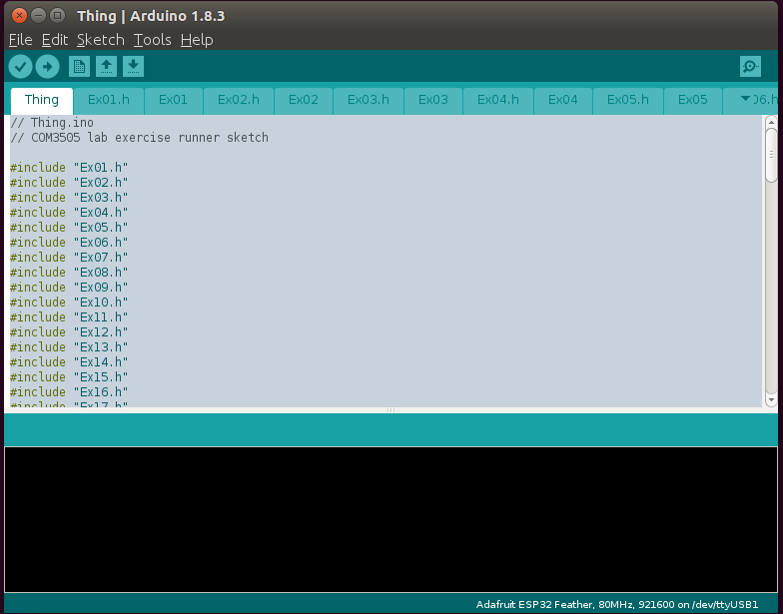
Arduino IDE (in brief: more next week!)
Editing a “Sketch”
The IDE is very basic… why use it?
easy to get started
File>Examples
Sketch>Include Library
Community support
But: we’ll also move beyond the IDE later on...

Slide 28
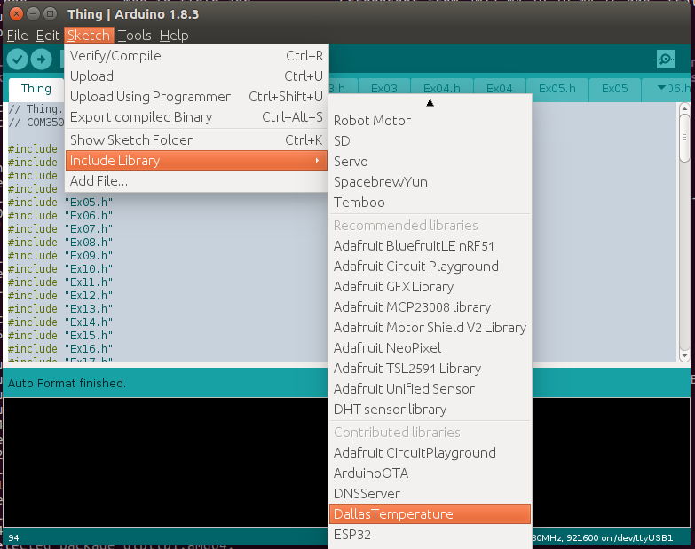
Including a Library
(Though note that the libraries we will be using will be set up in your
filespace by scripts you’ll run in the lab tomorrow.)

Slide 29
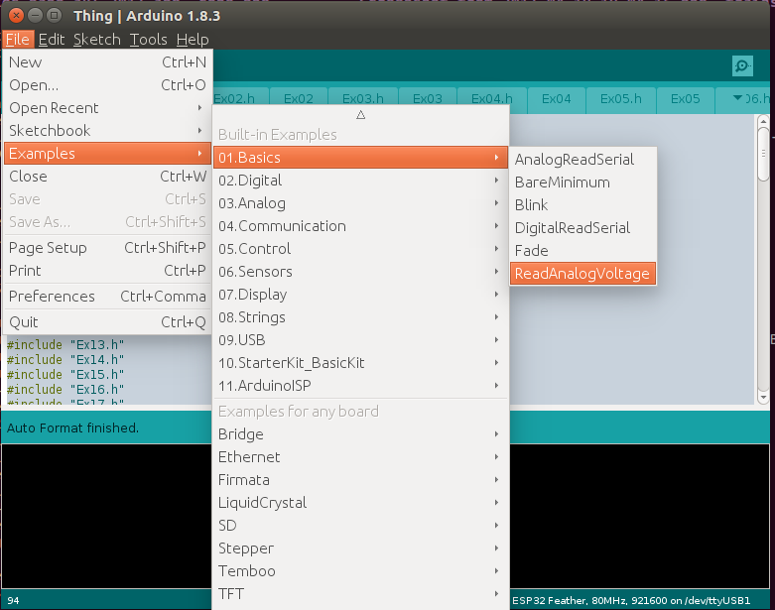
Example Code
Don’t panic: this week we’re just blinking LEDs and the like! And there are LOTS of examples in the IDE

Slide 30
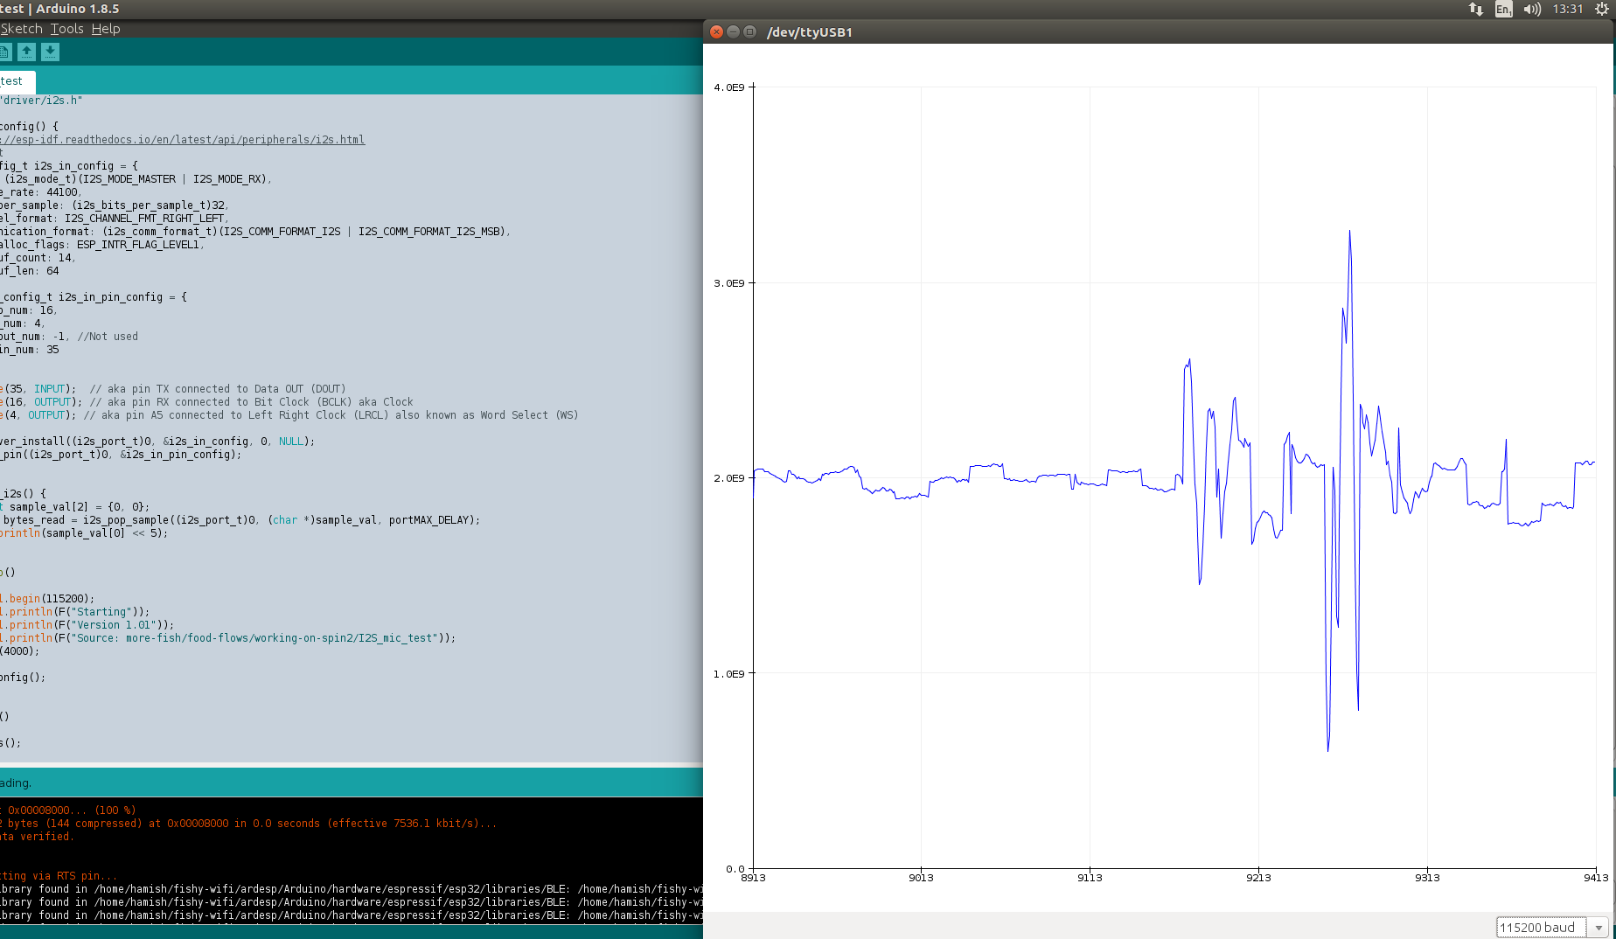
Cool stuff for later on
Use the serial plotter to see waveforms (Arduino IDE Tools menu, or Cntrl&Shift&L):

Slide 31
Infrastructure (1): various cloud services
Commercial services:
if this then that: IFTTT
from a 2018 student: “I'd like to thank you for teaching this module. Today I was offered my first graduate job since graduating not 2 weeks ago. During the interview process I had to complete as a view to seeing how I would work to solve a problem. I was told I needed to make it such that if someone is mentioned on twitter, an email must be sent to a certain address. ...”
adafruit.io and other dashboard providers
...a whole smörgåsbord of others from all the big players
Our own service: the COM3505 cloud server. Example:
https://HOSTNAME.shef.ac.uk:9194/com3505-2021?...data… [bonus points: why “not secure”?]
data format: key=value, e.g.: email=hamish@gate.ac.uk
it requires a .ac.uk email address — and in week 1 please send your GitLab ID
so to send your email and to our server do:
https://HOSTNAME.shef.ac.uk:9194/com3505-2021? email=h.cunningham@shef.ac.uk&gitid=MyGitLabID

Slide 32
GitLab in COM3505
You create a repository on gitlab.com and add @hamishcunningham as a maintainer.
You tell us the GitLab ID that you’re using, and your Sheffield email address.
I pull down your repos and snapshot them each week. We also provide a course repository with exercises and example code solutions.

Slide 33
Labs: soldering, breadboards, measuring, IDE
EE lab, DIA 2.02,:
breadboarding
soldering a little example PCB
generating (an AC) signal
measuring voltage and resistance
setting up your gitlab repo
setting up the Arduino IDE etc.
you should already know all this: sheffield.ac.uk/diamond/hs: no food, no phones, bags in cupboards (don’t trip!), soldering irons get hot!, etc. etc.: READ IT!
Why learn to prototype circuits?
the more we can build locally, the more resilient we are
there’s a new raft of opportunity around modern embedded computation
a little knowledge goes a long way
Why learn to solder?
more robust than breadboards
promotes manual dexterity
exercise another part of your brain! (avoid Alzheimers!)

Slide 34
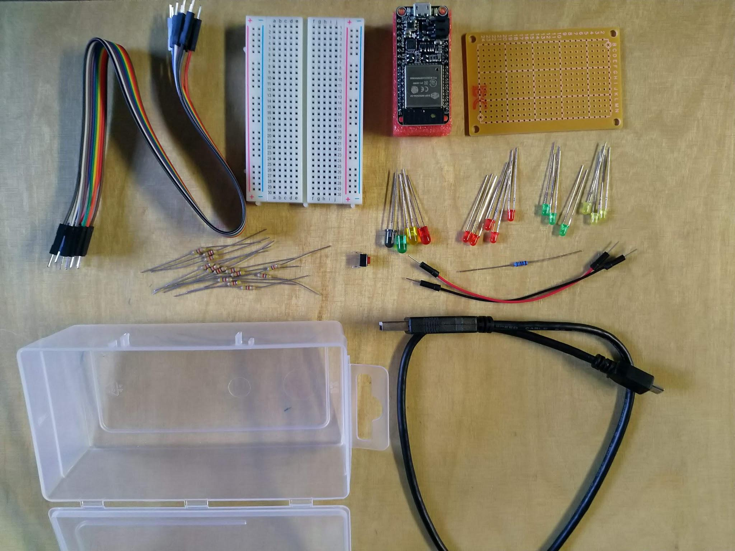
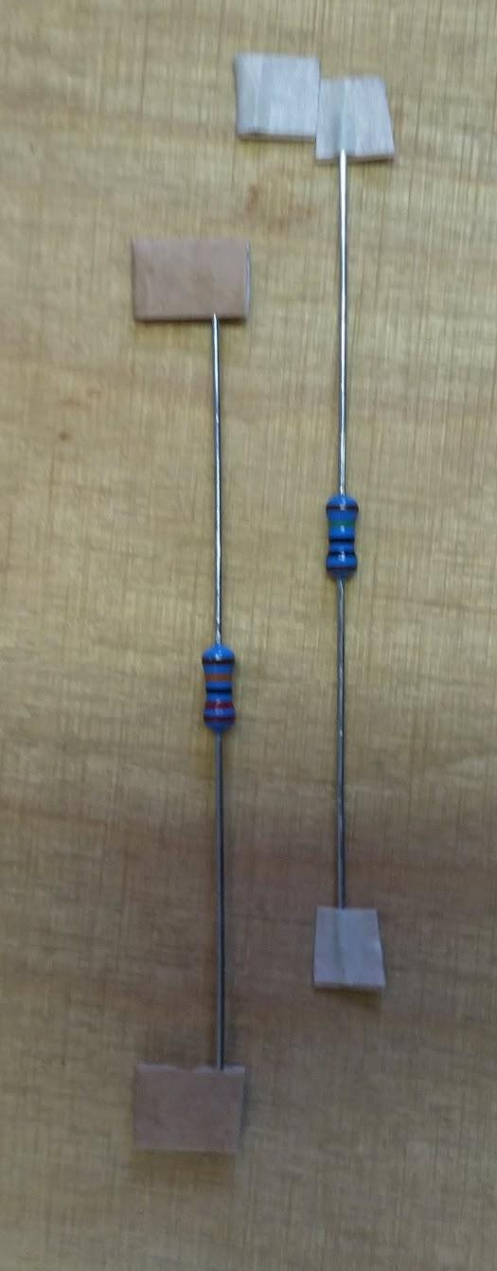
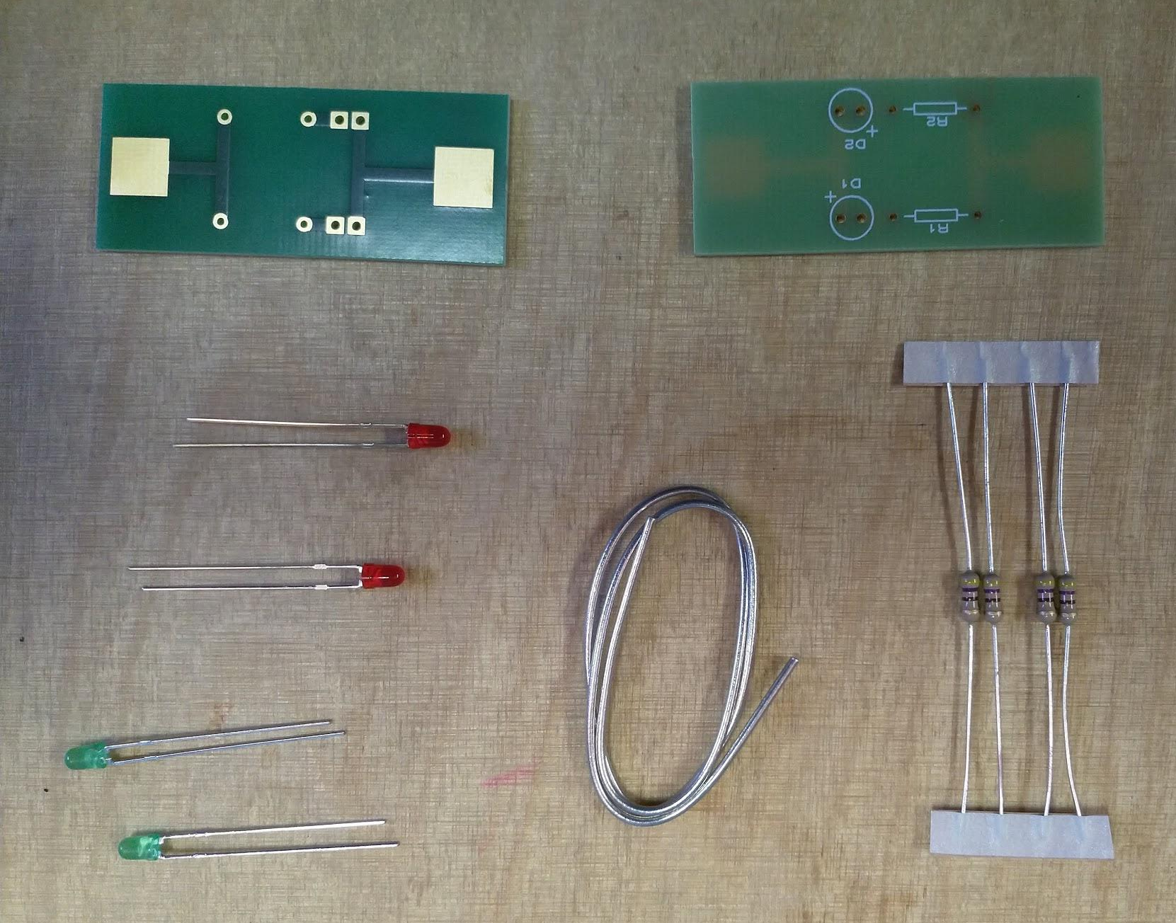
Lab kit (weeks 1—8)
Adafruit ESP32 Feather Huzzah
micro USB cable
breadboard; matrixboard
LEDs
4.7kΩ resistors
180Ω, 1MΩ and 220kΩ resistors
SPST switch (single pole / single throw, push-to-make, momentary, duplicated pins)
jumpers: 2 power, 10 assorted
basic LED circuit (packs of 2, 1 per pair)
two printed circuit boards (PCBs)
two LEDs
two 470Ω resistors
solder

Slide 35
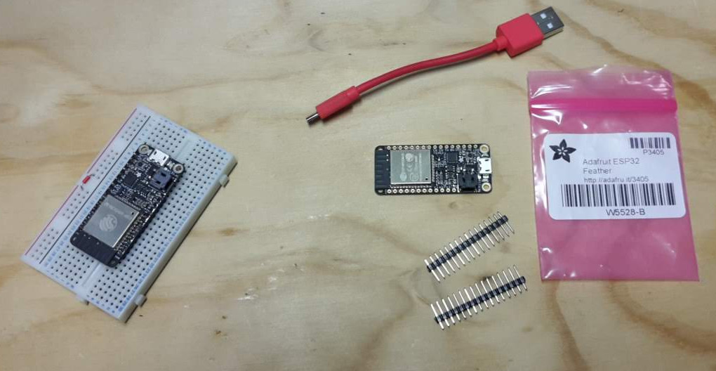
Soldering the headers on the FeatherWings
FeatherWings come without headers attached
we need headers that we can fit to a breadboard, for example
the board is supplied with low-profile headers
in the lab you can practice soldering on a small example PCB
later in term you will need (depending on project choice) to solder headers onto a FeatherWing

Slide 36
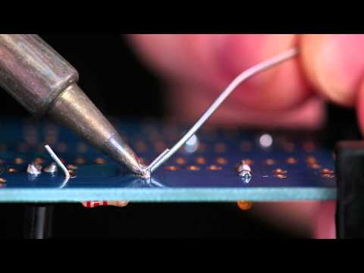
Soldering basics

Slide 37
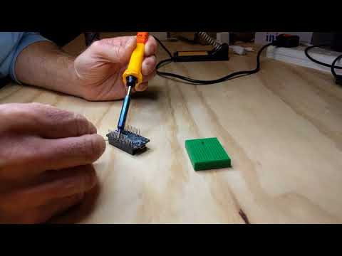
Soldering Feather[Wing] headers
Gotchas:
board wrong way up
dry joints (check conductivity)
headers not seated properly (need to be at exactly 90°)
leaving solder on the pins (5:00, 7:00)
bending the pins when breadboarding

Slide 38
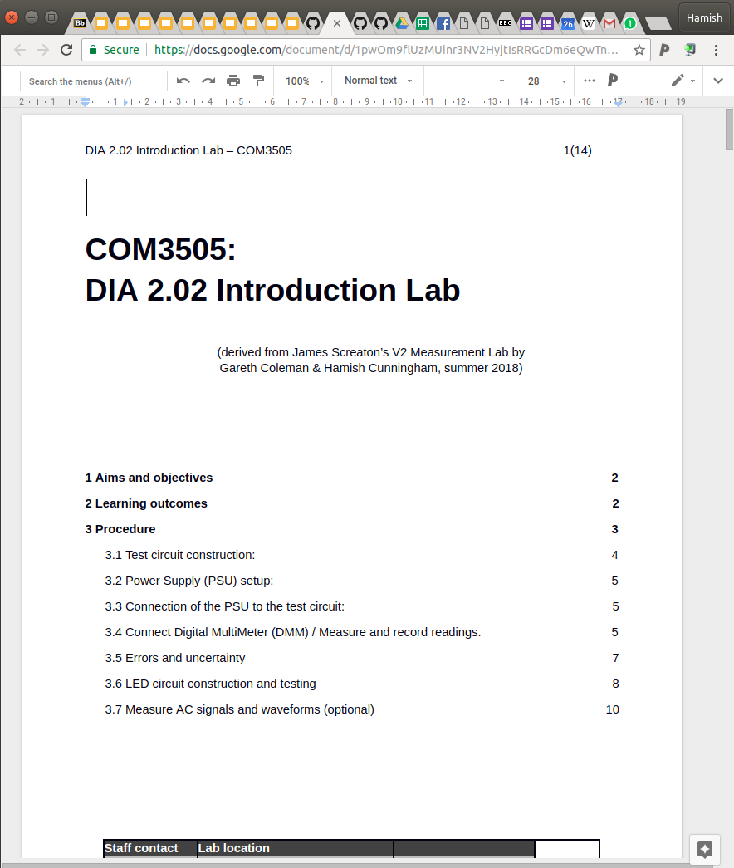
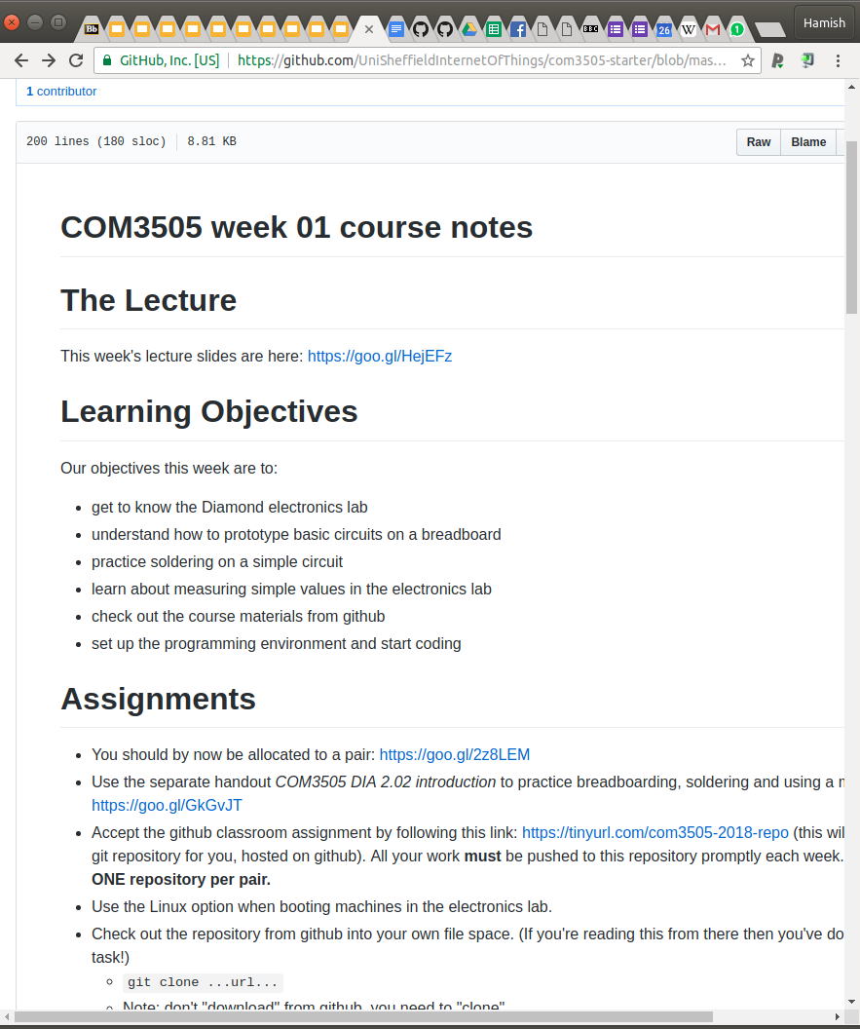
And now… the labs!
create a GitLab repo called com3505-2019-student and invite Hamish as a maintainer — see the week zero notes for details
get into your team (mostly pairs) and get a workstation; there are ~70 teams & ~70 workstations!
you should already know all this: sheffield.ac.uk/diamond/hs: no food, no phones, bags in cupboards (don’t trip!), soldering irons get hot!, etc. etc.: READ IT!

Slide 39
Changes in 2022 (iteration 5)
TODO delete? covered earlier now?
no teamwork :( (you can make informal teams, but will be assessed singly)
less lab time (after Easter?)
we post you the kits (one now, one after Easter), or pickup from DCS
example code and notes up-front: work at your own pace on your own schedule
threshold and grading assessment
so: a lot of this is new to us, just as it is new to you!
if you see errors or omissions, or you can think of a better way, get in touch!
route number 1: the discussion board
email: hamish@gate.ac.uk

Slide 40
Demo(s)
<<setting up a GitLab repo>>
<<SDK setup, Thing and HelloWorld>>

Slide 41
Questions from Me...
Are you….
...in Sheffield?
...elsewhere in the UK?
...abroad?
Is your network…
...brilliant?
...ok?
...unreliable?
Do you have a parts kit?
...yes?
...no (I’m in Sheffield)?
...no (I’m outside Sheffield)?

